Slide 1








HOME ALONE GAME
Presented by: Rafael Gerotto Coelho

Slide 2

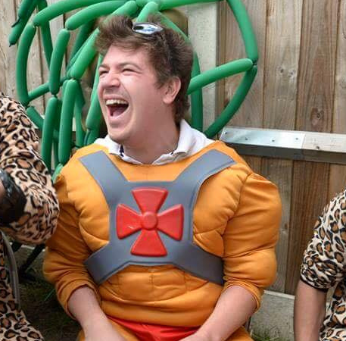
ABOUT ME
My name is Rafael Gerotto Coelho, I’m 34 years old from Brazil living abroad for more than 10 years, 4 of this 10 years in Barcelona, I have background in graphic design, and now I decide to move to another steep of learning.
Since I moved to europe I never work with my background degree, after many years i decide to go for new learnings, that’s way I choose a Bootcamp.
As you can see in the photo, I’m always smiling.

Slide 3
ABOUT MY PROJECT
I start building a game where you need to find a special character
My project was look like a memory game, but instead you find a combination, you just need to find a specific card.
I’m in love with Home Alone movie, so as in the move when the parents forget Kevin at home in christmas time, now is your turn to find kevin for them.
I set a time for the player to check all the cards before they flip back, before you click in the cards, you need to click in the START button for running the time.

Slide 4


CHALLENGE
my challenge is working with Javascript, first of all.
at the beginner I’m so scary about to be alone with Javascript, but later on we have some private time together we put our points on table, from now we have a deal, we gonna help it other.
find a way to flip at the beginner to flip for just a second.
I was a bit struggle with the correct way to add new coding for my game, so I need to push more to learning about the logic.

Slide 5

Fell for this kind of business sometime you just need 5 or 10 min to stop, briefing some pure air, and comeback to finish your project.
Since my first contact with this Bootcamp, I saw so much of my grow.
MY LEARNINGS
for 3 weeks was so much information in one goal, after many years out of a school was so hard to be open mind for new learnings, after week I fell mind open for more information, I’M READY FOR MORE.
learning as well most the time (in my case) keep it simple as Marcel sad.

Slide 6
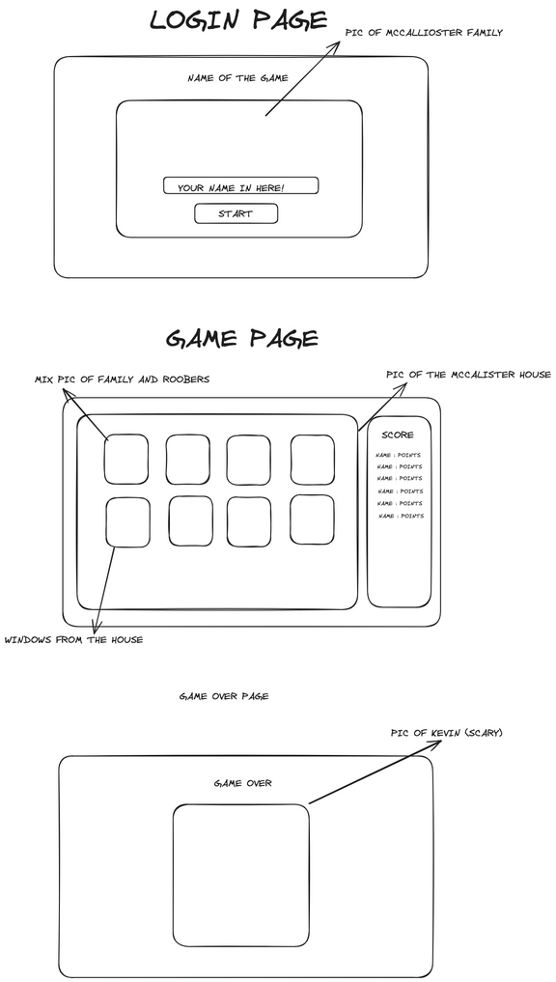
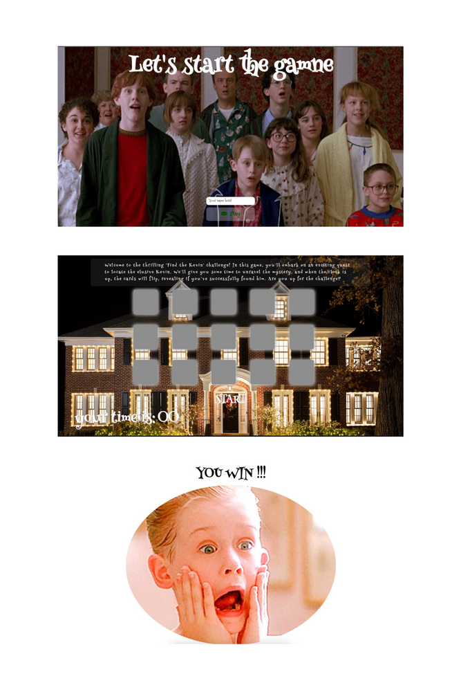



SKETCH FOR THE GAME

Slide 7

DEMO
HTTPS://RGEROTTO.GITHUB.IO/PROJECT-1/

Slide 8
HOME ALONE GAME
THANK YOU FOR LISTENING!
Don't hesitate to ask any questions!
Rafael Gerotto Coelho

